Slide 1
GUI Challenges

Slide 2
Challenge #1
Write a program that will display a joke. Don’t display the punchline until the reader hits the enter key.
Extension: display the punchline in a different colour.

Slide 3
The Code
from guizero import App, Text, PushButton
def display_joke(): #Method to call when button pressed
punchline.value = "Poke him on"
app = App("Joke teller") # Set up the app
joke = Text(app, "How do you get Pikachu on a bus?")
punchline = Text(app, text="", color="red")
button = PushButton(app, display_joke, text="Display punchline")
app.display()

Slide 4
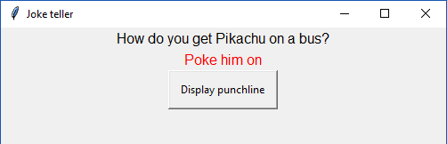
The Result

Slide 5
Challenge #2
Write a program that will ask you your name. It will then display ‘Hello Name’ where ‘Name’ is the name you have entered.

Slide 6
The Code
from guizero import App, Text, TextBox, PushButton
def display_greeting(): # Method to display the greeting
text.value = "Hello " + name.value
app = App("Hello machine") # Set up the app
text = Text(app, text="What is your name?")
name = TextBox(app)
button = PushButton(app, display_greeting, text="Greet me")
app.display()

Slide 7
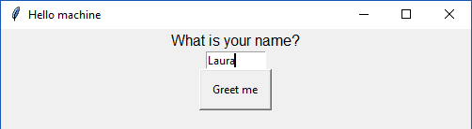
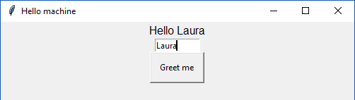
The Result

Slide 8
Challenge #3
Write a program to work out the area of a rectangle. Collect the width and height of the rectangle from the keyboard. Calculate the area and display the result.
Extension: Display the volume of a cuboid. See what happens when you don’t type in numbers! Try to explain what has happened and why.

Slide 9
The Code
from guizero import App, Text, TextBox, PushButton, error
# Method to calculate the area
def calculate():
# Validation to check whether they typed in numbers
if not height.value.isdigit() or not width.value.isdigit():
error("Input error", "You must type in numbers for height and width")
# Depth is allowed to be a digit or blank
elif not depth.value.isdigit() and depth.value != "":
error("Input error", "You must type in a number for depth")

Slide 10
The Code cont’d
# Perform the calculation
else:
area = int( height.value ) * int( width.value )
if depth.value == "":
result.value = str(area) + "cm squared"
else:
volume = area * int(depth.value)
result.value = str(volume) + "cm cubed"

Slide 11
The Code cont’d
# Set up the app
app = App("Area and Volume calculator", layout="grid")
width_label = Text(app, text="Width:", grid=[0,0], align="left")
width = TextBox(app, grid=[1,0], align="left", width=30)
height_label = Text(app, text="Height:", grid=[0,1], align="left")
height = TextBox(app, grid=[1,1], align="left", width=30)
depth_label = Text(app, text="Depth:", grid=[0,2], align="left")
depth = TextBox(app, grid=[1,2], align="left", width=30)

Slide 12
The Code cont’d
button = PushButton(app, calculate, text="Calculate", grid=[1,3])
result_label = Text(app, text="Result:", grid=[0,4], align="left")
result = TextBox(app, grid=[1,4], align="left", width=30)
app.display()

Slide 13
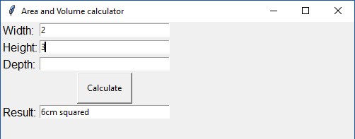
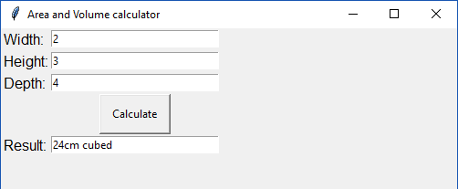
The Result

Slide 14
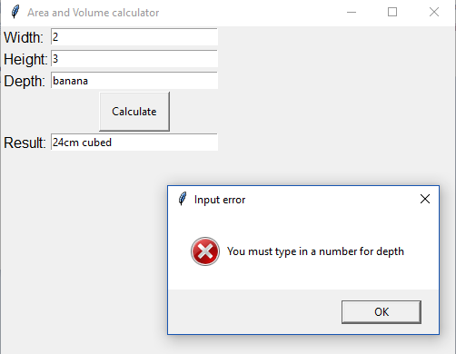
The Result
You will get an error if you attempt to use letters because the program uses integers. (Remember this from previous programs?)

Slide 15
GUI Zero Reference Guide
The following is a great resource for using GUI Zero, if you would like to explore further:
https://lawsie.github.io/guizero/about/

Slide 16
Reference
https://codeboom.wordpress.com/2017/01/07/gui-zero-making-python-guis-really-simple/

